Slide 1

Micro Credit Card Defaulter project
Presented By:
Shivanchal Asthana

Slide 2

Table of Content
Introduction
Benefits of Customer Retention
Problem statement
Objectives
Research Methodology
Data Analysis/ Visualizations/ Observations
Conclusions

Slide 3
Introduction:
A Microfinance Institution (MFI) is an organization that offers financial services to low income populations. Many microfinance institutions (MFI), experts and donors are supporting the idea of using mobile financial services (MFS) which they feel are more convenient and efficient, and cost saving, than the traditional high-touch model used since long for the purpose of delivering microfinance services
Today, microfinance is widely accepted as a poverty-reduction tool, representing $70 billion in outstanding loans and a global outreach of 200 million clients.
We are working with one such client that is in Telecom Industry. They are a fixed wireless telecommunications network provider. They have launched various products and have developed its business and organization based on the budget operator model, offering better products at Lower Prices to all value conscious customers through a strategy of disruptive innovation that focuses on the subscriber.

Slide 4
What is Micro-Credit?
Microcredit is an extremely small loan given to those who lack a steady source of income, collateral, or any credit history. It aims to support and kickstart entrepreneurs who are unable to obtain the financial backing needed to start a small business or capitalize on an idea.
Microcredit is also part of microfinance, a line of finance that aims to help people of a lower socioeconomic background through catered financial services, which include savings accounts and loans.
How Micro-Credit works?
Microcredit was built on the concept that people with skills and more entrepreneurial mindsets also came from impoverished countries that did not necessarily have access to financial services that could suit them.

Slide 5
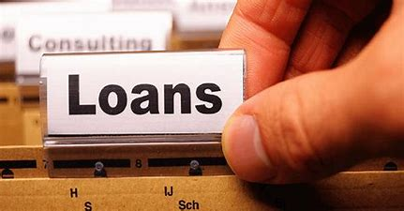
About Problem Statement:
For this project, Our client provide us the sample data from their client database, In order to improve the selection of customers for the credit, the client wants some predictions that could help them in further investment and improvement in selection of customers.

Slide 6

Objectives:
Build a model which can be used to predict in terms of a probability for each loan transaction, whether the customer will be paying back the loaned amount within 5 days of insurance of loan. In this case, Label ‘1’ indicates that the loan has been payed i.e. Non- defaulter, while, Label ‘0’ indicates that the loan has not been payed i.e. defaulter.

Slide 7
Research Methodology
The research methodology adopted for this is given as follows:
Research design: The research design adopted for this study is descriptive research design. The descriptive research design focuses on the accurate description of the variables present in the problem.
Sampling: Sampling allows concentrating upon a relatively smaller number of people and hence, to devote more energy that the information collected from them is accurate.
Sampling Size: The total size of the sample is 209593 respondents.

Slide 8
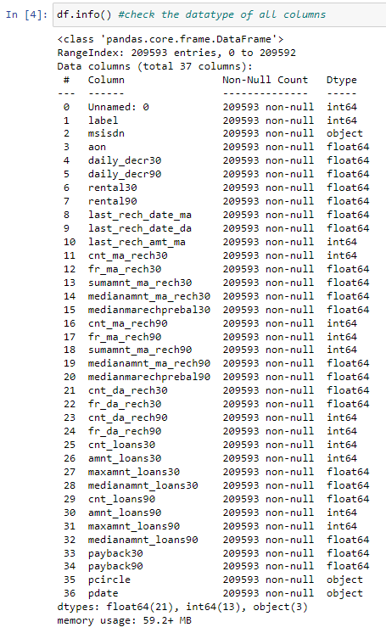

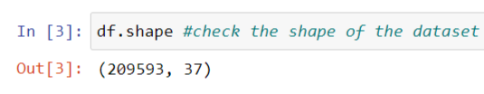
Data Analysis and Interpretation
Observations:
By observing info of this dataset, we can clearly see, the datatypes of this dataset, mostly are in int and float, three are in object.
There are no duplicate values in this dataset.
We can see the shape of the dataset.

Slide 9
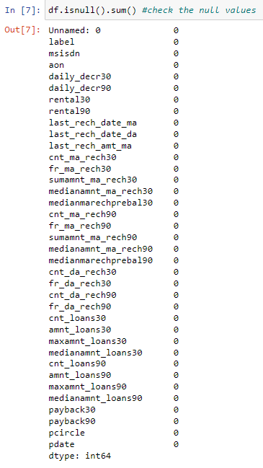
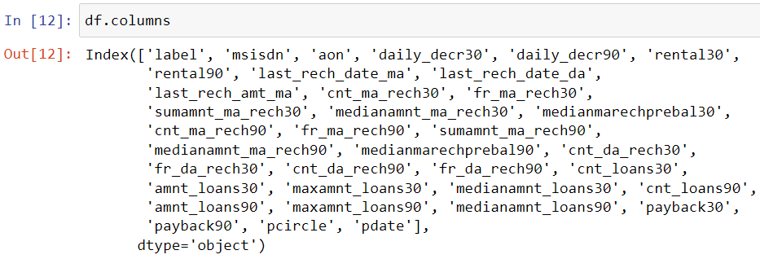
Observations:
There is no Null found in this dataset
We can see the naming convention of columns

Slide 10
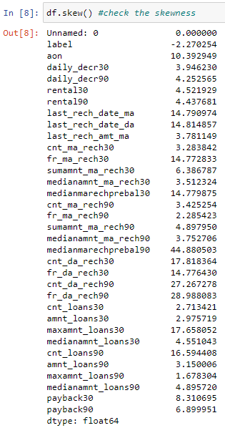
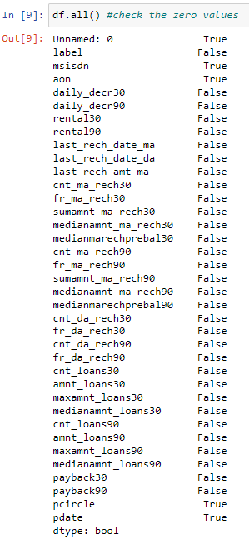
Observations:
We can see the skewness of every column.
Mostly columns are positively skewed.
Our Target column is negatively skewed.
If we see, second image, mostly column contains zero value.

Slide 11
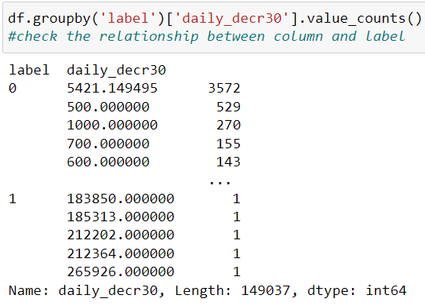
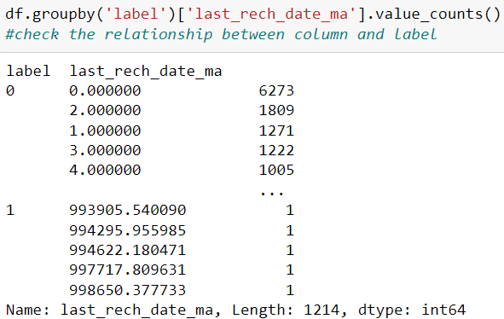
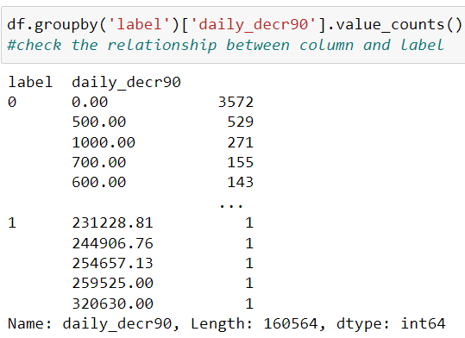
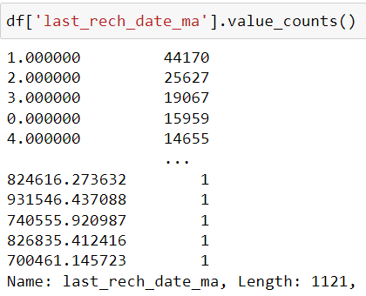
Observations:
1. Mostly, life of cellular network is less in days.
2. Mostly, peoples are spending daily amount is less 26500 in ( Indonesian rupiah)
3. We can see, mainly people unable to pay back the amount where daily average amount is less.
4. We can see, mostly failure in loans when daily average spent amount is less.
5. Number of days of last recharge of main accounts are very less, means user are frequently recharge their main account.

Slide 12
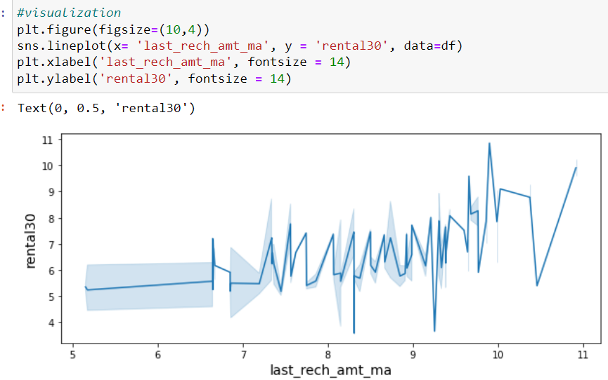
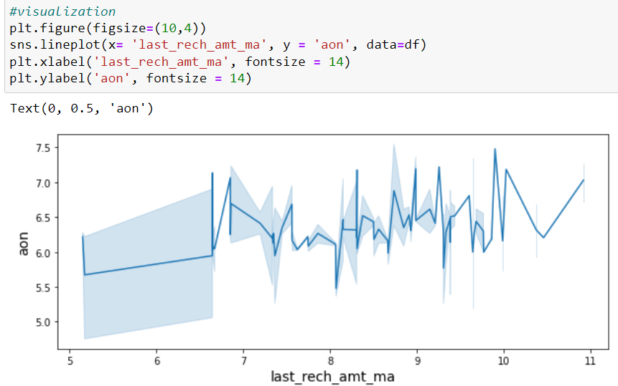
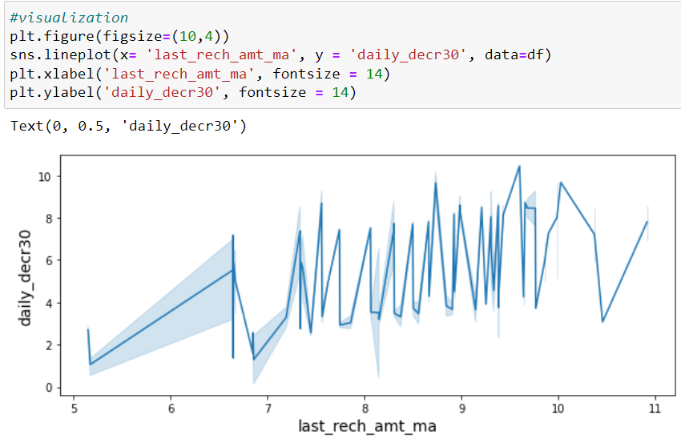
Observations:
1. We can clearly analyze by value counts method, that people who do low amount of recharge are higher than others.
2. We can see here, the daily amount spent averaged over last 30 days is increasing as the last recharge amount is increasing
3. Average main account balance is also proportional to last recharge amount
4. As the age of cellular network increases, the last recharge amount is increases.

Slide 13
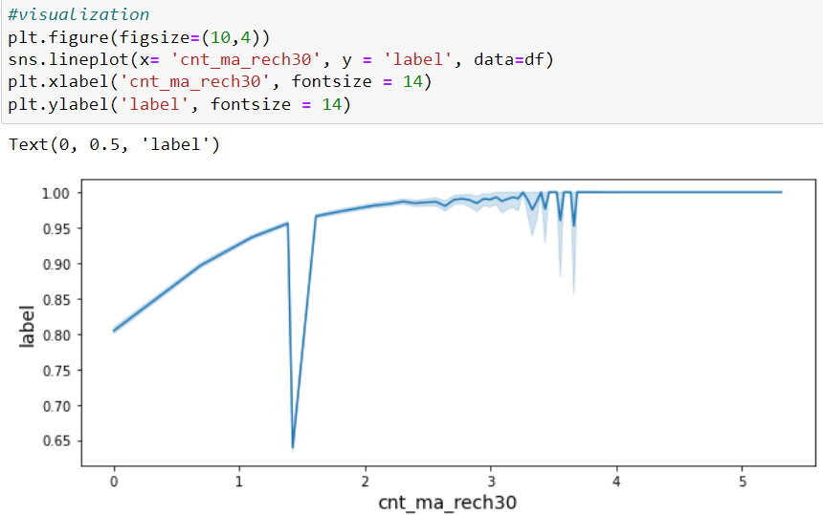
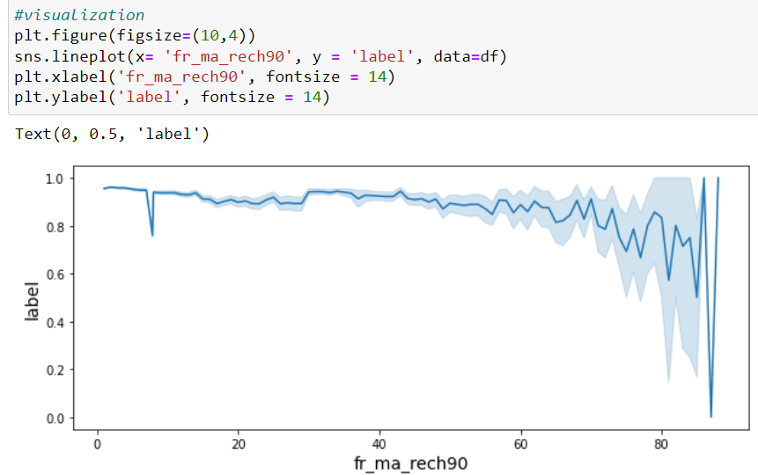
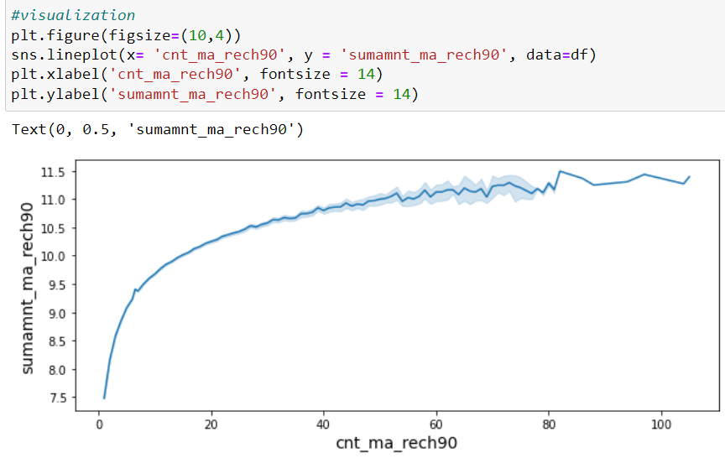
Observations:
1. One times recharge is more than others
2. Mostly people have done 4 times recharge when we compare it to age of celluar network in days
3. As the daily amount spent is increases, the main account got recharged more
4. As we see, Number of times main account got recharged, the average main amount balance increases.
5. We can see clearly, people do recharge 4 times in 30 days, when their recharge amount is less
6. We can see, people who do 1 0r 2 times recharge their success rate is less than others.

Slide 14
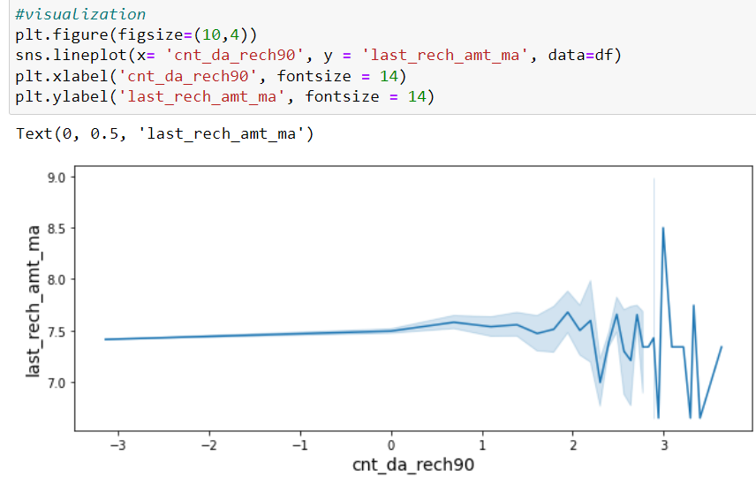
Observations:
People who do less amount of recharge their success rate is very less
As the number of frequency of recharge increases, recharge amount is also increases.
3 times data account is recharged for approximately low to medium recharge values
As the daily amount spent increases, number of loans are also increases
Average amount balance increases increases when number of loans also increases
More peoples are recharged their account and takes 4 times loan
7. As the age of cellular network increases, number of times loans taken by users are increases slightly.
8. Success rate is high when amount of taking loan is high
9. Amount of loans is high because Amount of daily spent is high
10. We can see clearly, amount of loan increases, when the total amount of recharge in main account increases.
11. success is higher for users taking total amount of loans in last 90 days
12. Daily amount is higher that’s why users taking more amount of loans
13. Main account balance is high because users taking more amount of loans

Slide 15
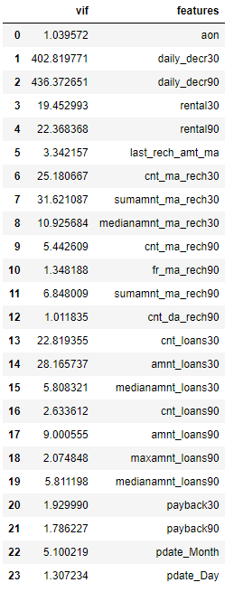
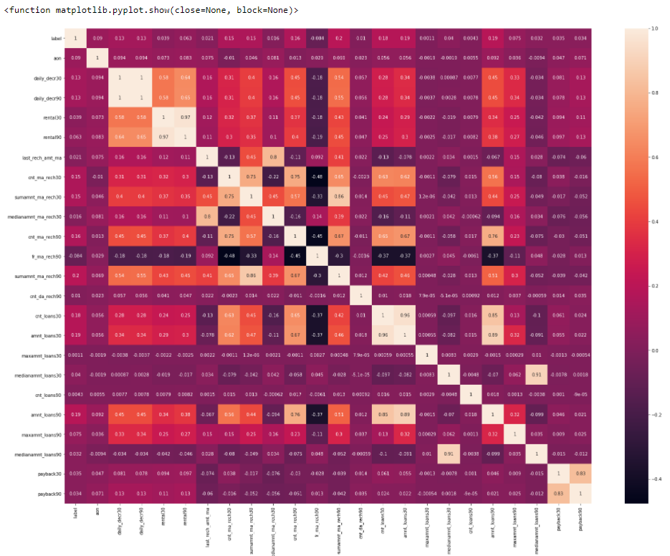
Treating Multicollinearity:
We can see here, there are many columns that have high multicollinearity with each other, so, we can easily drop that column and remove multicollinearity.

Slide 16

Model Building:
In this project, We have used 5 models along with their hyperparamter tuning to improve accuracy.
Logistic Regression
Decision tree Classifier
KNN Classifier
Random Forest Classifier
Support Vector Machine
We also use Bagging Classifier with Bootstrap = True and False

Slide 17
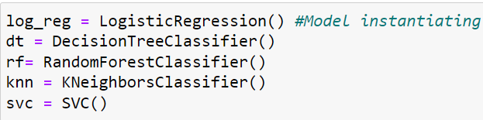
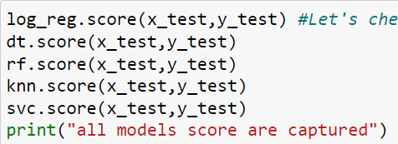
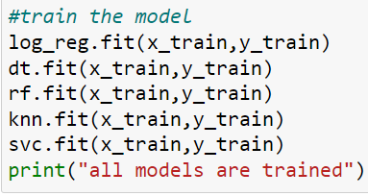
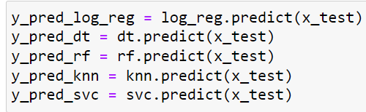
Model Building
We are now checking the accuracy on all 5 models.

Slide 18
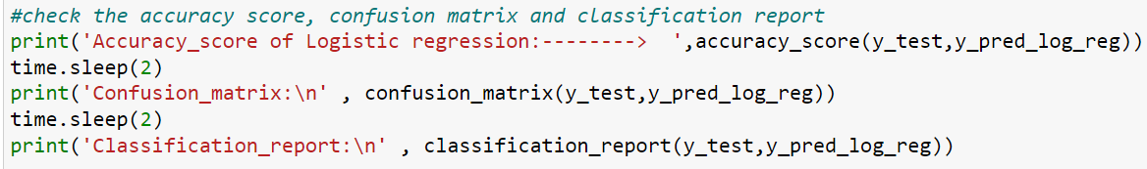
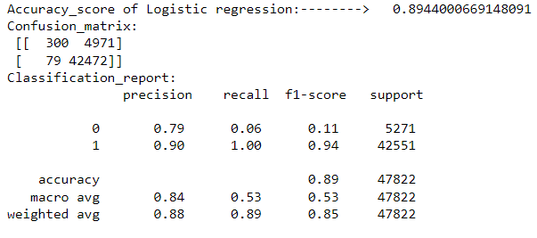
Logistic Regression:
Logistic Regression is giving us 89% accuracy

Slide 19
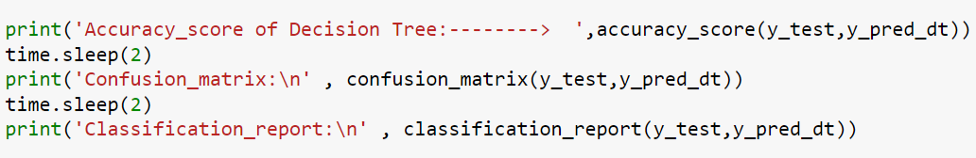
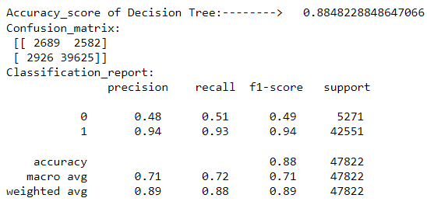
Decision Tree Classifier:
Decision Tree Classifier is giving us 88% accuracy

Slide 20
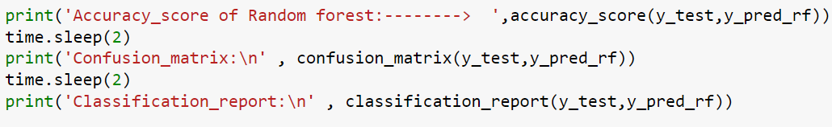
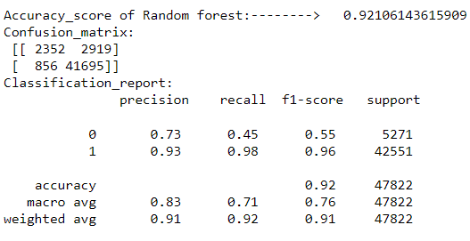
Random Forest Classifier:
Random Forest Classifier is giving us 92% accuracy

Slide 21
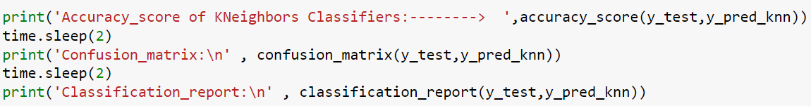
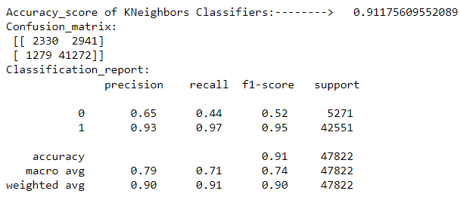
KNN Classifier:
KNN Classifier is giving us 91% accuracy

Slide 22
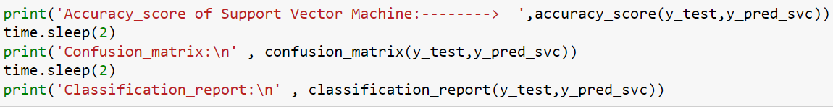
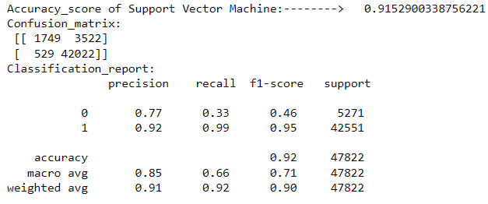
Support Vector Machine:
Support Vector Machine is giving us 92% accuracy

Slide 23
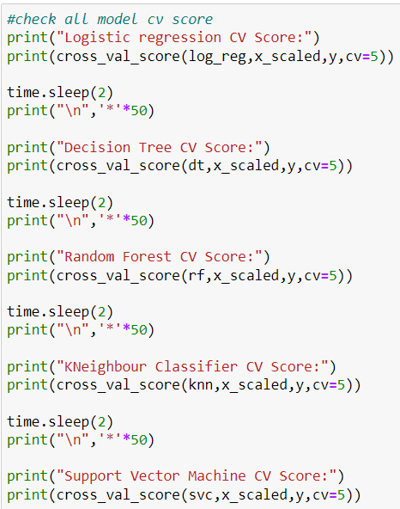
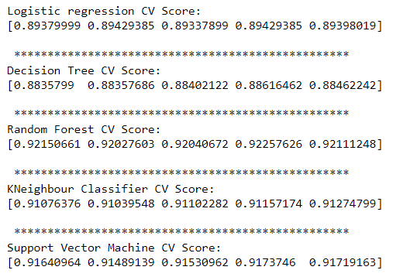
Cross Validation Score of all 5 models:
CV Scores of all 5 models where value of CV is 5

Slide 24
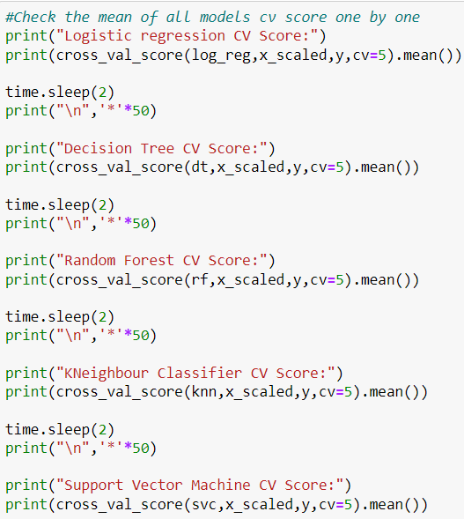
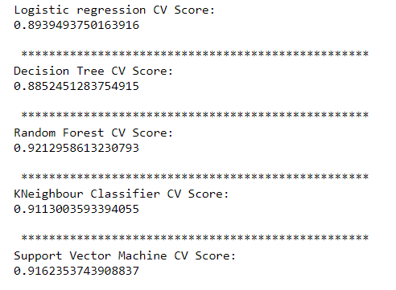
Mean CV Score:
We can see, RandomForest Classifier is giving us best accuracy

Slide 25
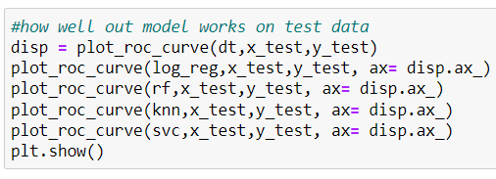
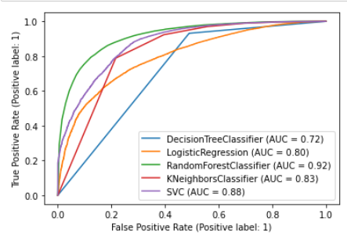
AUC/ROC Curve:
We can see here, The AUC score of RandomForest Classifier is best out of all models

Slide 26
Saving The best Model:
We can conclude easily now by observing the Accuracy scores, CV Scores, difference between the Accuracy scores and cv score, and AUC Score, We can say Random Forest is our best model because it is giving us best parameters.

Slide 27
Conclusion:
Mostly, the customers have the intension of repaying. There are certain cases, when the customers have no intension of repayment but the number of such customers are few. With the model built, we can certainly determine customers having intension of repayment or not.
The dataset was full of outliers, skewness and unbalanced data which was the biggest challenge to overcome. Hence data cleaning was very important to get proper prediction. I have used Logistic Regression, Decision Tree, Support vector machine, KNN classifier, Bagging classifier and Random Forest Classifier. Among all of them algorithms Random Forest Classifier gave the best outcome. As the dataset was unbalanced, the other algorithm may overfit and can come out with wrong prediction whereas Random forest can control overfitting and give best prediction.
The solution can be applied to the customer having a transaction history but the model may not perform well with customer having new profile and no transaction history. Nevertheless, the model will perform well with customer having transaction history and can predict whether a person will be a defaulter or non-defaulter. Hence, we can say that this statistical model will be helpful in future for the prediction of micro credit defaulter and non-defaulter customer.

Slide 28
Thankyou

